Slide 1
Continuous integration / continuous deployment (CI/CD)
Eduardo Patrocinio eduardop@us.ibm.com
Jim Palistrant palistra@us.ibm.com

Slide 2
Objectives
After completing this lecture, you will be able to:
Describe the Continuous Integration and Continuous Deployment capabilities in IBM Cloud Private (ICP)
Describe and position build automation technologies in ICP private
Recommend best practices for automating enterprise ICP deployments
Position UrbanCode Deploy with ICP

Slide 3
Agenda
CI/CD pipeline in ICP
Build tools (build/ship/run)
Deployment Environments (build/ship/run)

Slide 4



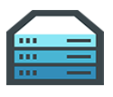













Docker Mission
Docker is an open platform for building distributed applications for developers and system administrators – Build/Ship/Run
Build
Ship
Run
Any App
Anywhere

Slide 5
Definitions
CI is Continuous Integration (Build/Ship)
Builds, unit tests, integration tests, performance tests, …
CD is Continuous Deployment (Run)
Deploying and maintaining pre production and production environment
CI is Dev, CD is Ops, so CI&D is DevOps (Build/Ship/Run)

Slide 6

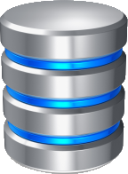
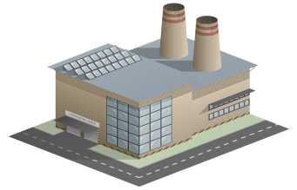


ICP Continuous Integration (Build/Ship/Run)
Frequently performing all of these steps in sequence:
Development
Rapidly implementing changes in small, tested batches
Source Code Management
Merging changes from multiple developers
Build
Creating new deployment artifacts
Package
Installing builds into runtimes
Releasing runtimes as immutable images
Development
SCM
Build
Package Repo
Continuous Integration
Squad/Team Level Automation
ICP

Slide 7





ICP Continuous Deployment (Build/Ship/Run)
Release Train
Rapidly progressing the latest packaged build through the test lifecycle stages and into production
Deploy to Test
Perform functional testing
Deploy to Stage
Rehearse production deployment
Perform integration testing
Deploy to Prod
Make the build available to users
Configure:
Applications
Middleware
Databases
APIs
Package Repo
Deploy
Test
Stage
Prod
ICP
Rules for promotion
Release
Automated Test Deployments

Slide 8
ICP CI/CD (Continuous Delivery) pipeline
Release Train
Configure:
Applications
Middleware
Databases
APIs
Development
SCM
Build
Package Repo
Deploy
Test
Stage
Prod
ICP
Continuous Integration
Rules for promotion
Squad/Team Level Automation
Release
Development/Test/Production parity
Automated Test Deployments

Slide 9
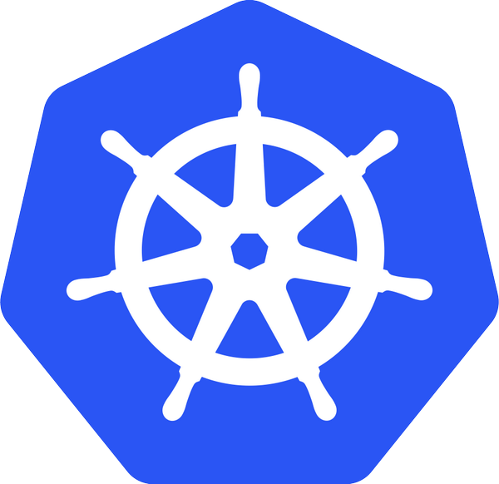

Automation
Helm
A package manager for Kubernetes
Enables multiple Kubernetes resources to be created with a single command
Deploying an application often involves creating and configuring multiple resources

Slide 10

Jenkins
Popular open-source framework for Continuous Integration
Monitors execution of repeated jobs; examples: cron jobs or builds
Generally used for:
Building/testing software projects continuously
Monitoring executions of externally-run jobs, such as cron jobs

Slide 11





Helm Deployment
ICP
Dev
ICP
QA
Test
StagingQA
Code config change
Build
Deploy Helm Chart
ICP
Prod
Production Deployment
Dev
Registries
Registries
Registries
Registries
Registries
Triggers Helm
Triggers unit test
Triggers system test
Single build process
Environment file to deploy to different environments
Scripts, etc. treated as code and stored in Git
Triggers build

Slide 12
Quality gates and trusted, secure image repo
ICP
Dev
ICP
QA
Test
StagingQA
Code config change
Build
Deploy Helm Chart
ICP
Prod
Production Deployment
Dev
Registries
Registries
Registries
Registries
Registries
Triggers Helm
Triggers unit test
Triggers system test
Triggers build

Slide 13
Deployment to Hybrid
ICP
Prod
Production Deployment
ICP
Dev
ICP
QA
Test
StagingQA
Code config change
Build
Deploy Helm Chart
Other Environment
Prod
Production Deployment
Production releases of hybrid applications / services across enterprise
Dev
Registries
Registries
Registries
Registries
Registries
Triggers Helm
Other Environment
Prod
Production Deployment
Triggers unit test
Triggers system test
Triggers build
Triggers deployment

Slide 14
This presentation is intended for an IBM internal audience only.

